Slide 1
Chapter 4 Design And Planning For Winter Sport Resorts
Simon Hudson

Slide 2
Topics Covered
Design and planning
Development approval
Site feasibility
Design guidelines
Development styles
Dealing with Seasonality

Slide 3
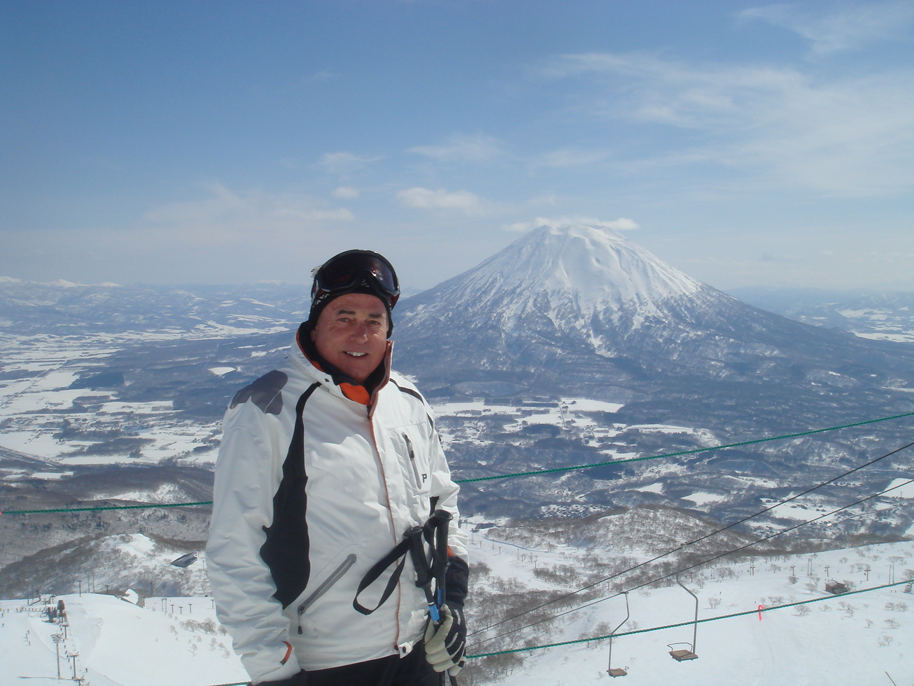
Spotlight Paul Mathews: World’s greatest ski resort designer
Paul Mathews
design ski resorts
Whistler-based company, Ecosign: “ecological design”
three important technological improvements

Slide 4
Design and planning
Key stages in the design of ski resorts
Development approval
Site feasibility
Design guidelines
Development styles

Slide 5
Proposed Jumbo Glacier Resort

Slide 6
Master Plan for Big White in British Columbia

Slide 7
Preau’s two scenarios of Alpine tourist development
Source: Adapted from Preau, 1970

Slide 8
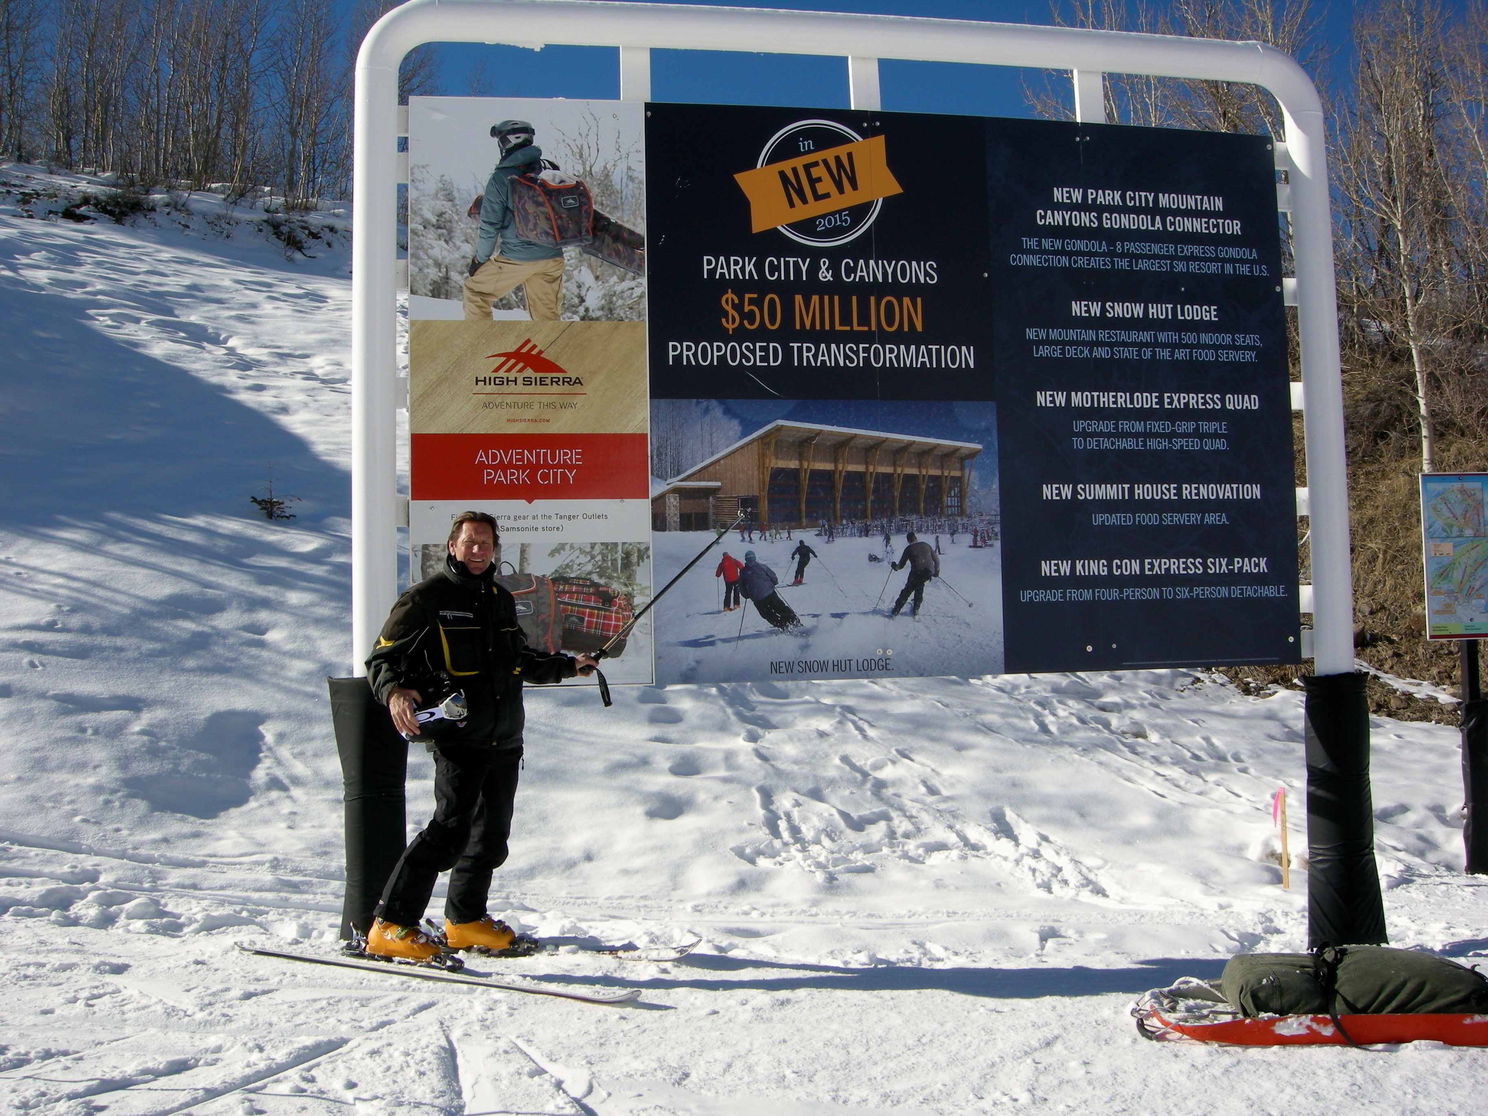
Profile Creating America’s biggest ski area
Vail Resorts: Park City and Canyons Resort
Cheaper for locals, new cut-price kid’s passes for residents
Cares about the community

Slide 9
Dealing with Seasonality
A critical issue
A mature phase of development
Climate and weather conditions: global warming
Institutional factors
Negative consequences & seasonal impacts
Strategies
confront global warming; investing heavily in snowmaking; product improvements; market diversification; four-season resorts; festivals and events; price differentials; developing new economic activities; seasonal closures

Slide 10
Seasonality at winter sports destinations: causes, consequences and cures
Consequences
Causes
Consequences
Causes
Cures
Cures
Negative
Receiving Area
Negative
Receiving Area
Climatic Factors
Climatic Factors
Limited Investment
Limited Investment
Confront Global Warming
Confront Global Warming
Sporting Seasons
Sporting Seasons
Low Return On Investment
Low Return On Investment
Invest In Snow
Invest In Snow
-
-
Making
Making
Supply Side Constraints
Supply Side Constraints
Reduced Tourism Expenditures
Reduced Tourism Expenditures
Product Diversification
Product Diversification
Special Events
Special Events
Congestion and Crowding
Congestion and Crowding
Two Centre Holidays
Two Centre Holidays
Sporting Attractions
Sporting Attractions
Negative Environmental Effects
Negative Environmental Effects
Market Diversification
Market Diversification
Problems For Employers
Problems For Employers
Four
Four
-
-
Season Resorts
Season Resorts
Seasonal Unemployment
Seasonal Unemployment
Events And Festivals
Events And Festivals
Hostility Towards Tourism
Hostility Towards Tourism
Price Differentials And Yield
Price Differentials And Yield
Management
Housing Issues
Management
Housing Issues
Employee retention
Employee retention
Co
Co
-
-
Operation And Partnerships
Generating Area
Operation And Partnerships
Generating Area
Positive
Positive
State
State
-
-
initiated measures
initiated measures
Release From Stress/Recuperation
Release From Stress/Recuperation
Aggressive Promotion
Climatic Factors
Aggressive Promotion
Climatic Factors
Time
Time
Seasonal Closures
Customs Or Holidays
Seasonal Closures
Customs Or Holidays
Time To Repair/Improve Infrastructure
Social Pressure Or Fashions
Time To Repair/Improve Infrastructure
Social Pressure Or Fashions
Some Seasonal Work Pays Well
Inertia
Some Seasonal Work Pays Well
Inertia
Complements Traditional Patterns of
Complements Traditional Patterns of
Employment
Employment
Chance For Ecological Environment
Chance For Ecological Environment
To Recover
To Recover
Source: Adapted from Hudson & Cross, 2005

Slide 11
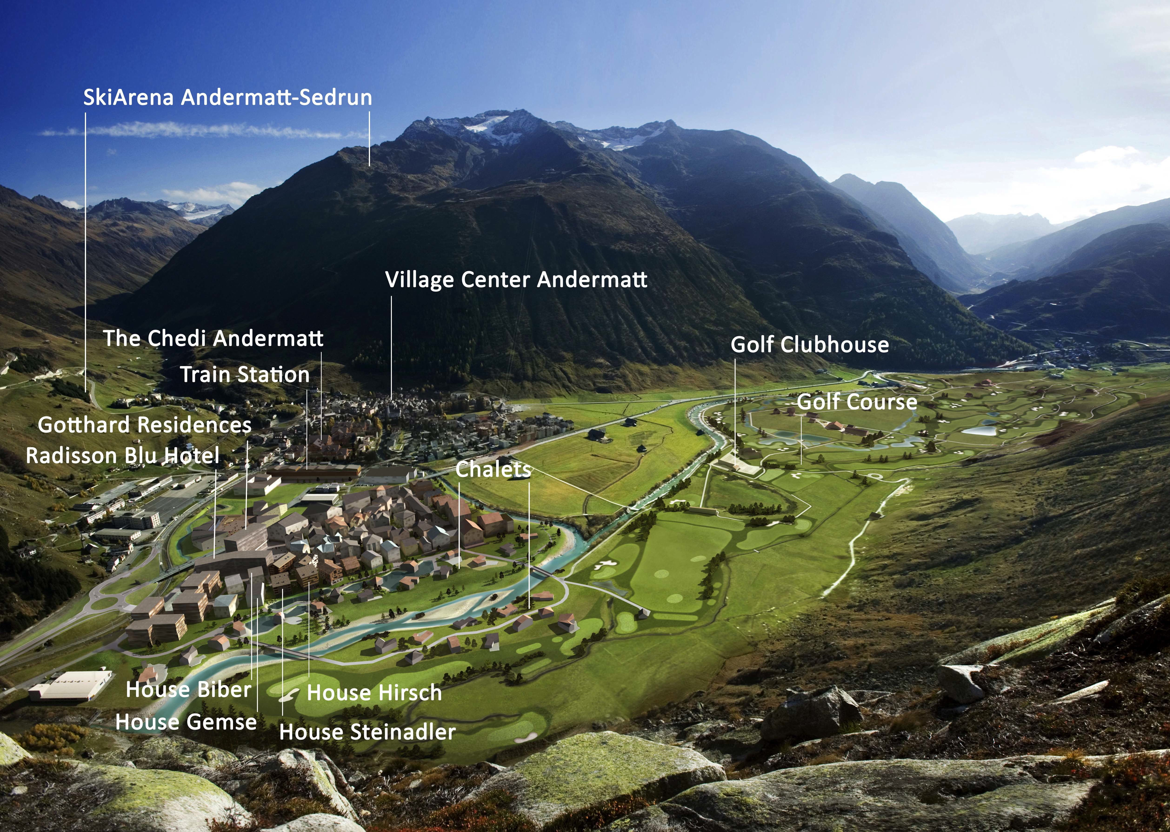
Case Study From humble to hedonistic: The gentrification of Andermatt, Switzerland
Transform Andermatt into a year-round resort
community collaboration
ski lift redevelopment
real estate development
a five-star, deluxe flagship hotel
create a stable, growing local community

